Slide 1
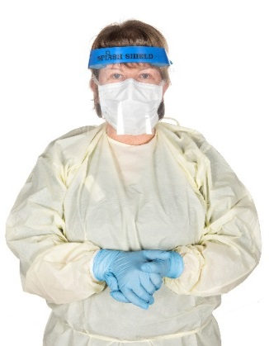
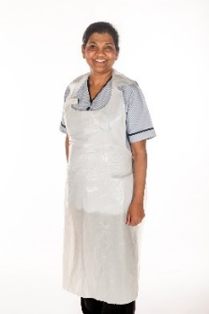
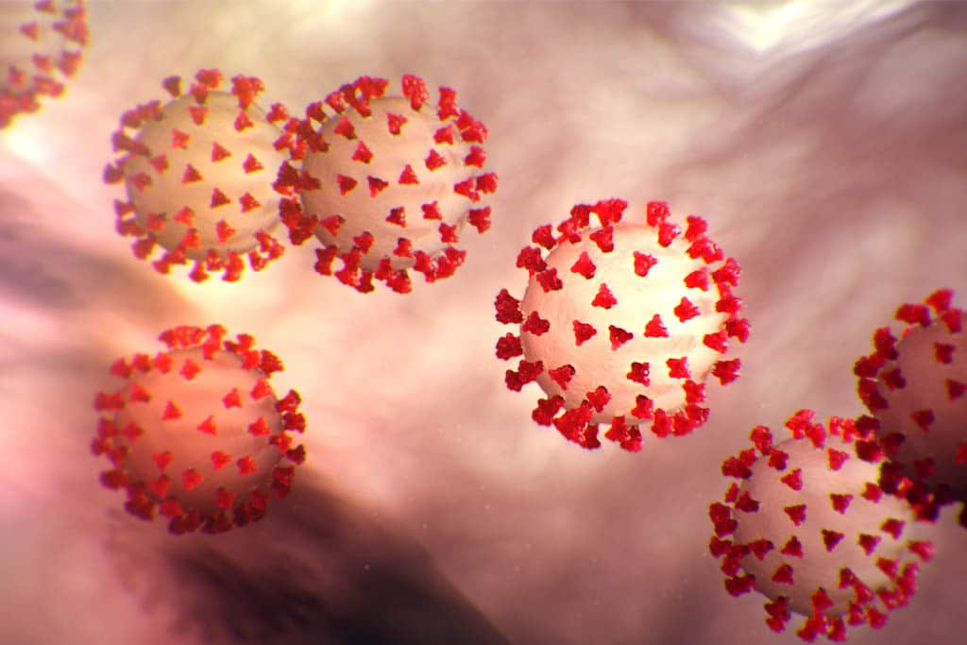
What can I do to help both in hospital and at home?
1. Please clean your hands regularly, especially: when they are soiled, after using the toilet and before eating. If you are in the Hospital and are unable to go to the sink in your room please ask the Nurse Manager hand wipes.
2. Please make sure you have your own toiletries and tissues while in hospital.
3. When coughing or sneezing use a tissue and turn your head away from others. Dispose of the tissue and clean your hands.
4. Do not touch your wounds, medical devices, drips or catheters.
5. Limit the amount of personal belongings in your hospital room, especially in your bedside locker and table. This helps staff keep your room as clean as possible which further reduces the risk of infection.
6. Please wear a mask when leaving your bed space.
7. Please let your family know that visiting is not allowed at the moment. This is to protect you, your family and healthcare staff. Ask your nurse about virtual visits using technology. Your loved ones can also email messages to SendingLove@tuh.ie which will be delivered to you.
8. If you are discharged during your contact period follow national guidance and do not go to any social gatherings, work, hospitals or clinics. Keep a two metre distance from others including your family.
Patient Care Packages
The Hospital have a patient care package service for relatives. Between 2pm & 4pm seven days a week. Your used clothes can be sent home in a special bag that can go straight into your washing machine without need to open it. Please ask the nursing staff for this bag and to bring it down to the desk for you by 1pm each day. Please note bags can only be dropped off at these times.
Where can I get further advice? For further advice and information, talk to the nurse looking after you or the nurse manager in charge of the ward. Further information for self isolation at home can also be found on the following link.
https://www.hpsc.ie/a-z/respiratory/coronavirus/novelcoronavirus/guidance/selfisolationathome/
The following are examples of personal Protection equipment worn by staff looks like:
PATIENT INFORMATION LEAFLET
PATIENT INFORMATION LEAFLET
COVID-19
Advice for Patients who are a close contact of a positive COVID Patient
We have made every possible effort to make sure that all the information provided in this leaflet is true, accurate, complete and up to date at time of publication.
References: HSE.ie & HPSC.ie
Publication Date:19/11/2020
Version 4.
MPINFEC038-02

Slide 2
This leaflet provides advice to people who have had close contact with a person who has been confirmed as COVID-19 positive.
What is Coronavirus/COVID-19?
Coronavirus/COVID-19 comes from a family of viruses that cause illnesses like the common cold to more severe diseases. Novel Coronavirus is a new strain, not previously identified in humans.
How does the virus spread?
People can catch the virus from other people who have the virus through inhaling small droplets when people cough or sneeze or through touching contaminated surfaces. Contaminated hands is the most common way the infection is spread.
What is a COVID-19 close contact?
Anyone who has had greater than 15 minutes face to face (less than two meters) contact with a confirmed case in any setting. This includes:
Sharing a room with a positive patient for longer than two hours.
Close contact with a Health Care Worker who has become positive
Living or sleeping in the same home as a positive person
What do I need to do if I am a close contact?
You will be informed if you have been in close contact with someone with COVID-19. You will be asked if you have any of the following symptoms. :
Fever, Cough, Difficulty breathing, Sore Throat, sudden loss of taste or smell, Muscle pain & Tiredness.
You may or may not be currently showing any symptoms as it can take 14 days for symptoms to show. If you develop symptoms while in hospital you will be screened.
If you have any of the listed symptoms you need to inform the nurse who is looking after you.
What is isolation and why might I be isolated while in hospital?
This virus can spread easily therefore special care is needed to reduce the risk of spreading it to other patients and staff. Some patients are also more at risk of infection. For these reasons it is necessary to accommodate suspected or confirmed COVID-19 patients in a single room. This is referred to as “isolation”.
Occasionally patients may be isolated with other positive patients in a dedicated ward also known as co-horting.
The ward staff will explain why you are in isolation and the extra precautions that will need to be taken. We understand isolation may be difficult for you, but the staff will do their best to make your stay in hospital as comfortable as possible.
Can I leave the room / bed space ?
We request that you limit your movements while in hospital and liaise with the nurse looking after you.
The door into the room will be kept closed at all times to help reduce the risk of any infection spreading. If you need to leave your room for treatment or an investigation you will be accompanied and staff will inform you of what precautions you need to take. You will be asked to wear a mask.
Please also wear a mask when you leave your bed space.
Being in isolation will not affect the care you receive.
What about eating or drinking?
Your meals will be brought to you. Your water jug will be filled up when needed. Eat well and keep yourself hydrated.
When will my room be cleaned whilst in hospital? It is important that your room is kept clean and tidy. The cleaning staff will clean your room and empty the bins daily.
Can I have visitors in hospital?
No, visitors are not allowed, unless there are exceptional circumstances. This is to protect you, your family and healthcare staff. This includes no visiting anywhere on the Hospital campus i.e. outside the Hospital / car park etc. This is to protect you, your family and healthcare staff.
Will my discharge from hospital be affected because I am isolated?
Usually there is no delay if you are returning to your own home, another hospital or a residential home
What happens when I go home?
If you develop any of the symptoms as outlined in this leaflet, when you go home you will need to self isolate and contact your GP. (Stay in a different room to your family). Your GP will advise you of the next steps. In the unlikely event that you cannot contact your GP please call HSE Live on 1850-24-1850.
If you are discharged during your contact period, we ask you to practice restricted movement for 14 days after your discharge. This means you limit your movement and interactions with others. You must avoid contact with immunocompromised people, the elderly or other vulnerable individuals.

